Slide 1


UNIVERSITY OF GHANA
SCHOOL OF ENGINEERING SCIENCES
COMPUTER ENGINEERING
BUILDING AN AI BASED PERSONAL TIME MANAGEMENT ASSISTANT
10895681 – KOFI NYAME
10885854 – EMMANUELLA NII LAMILEY LAMPTEY
10920593 – IMMANUEL JUSTICE MAC-ARTHUR
PROJECT SUPERVISOR - DR NII LONGDON SOWAH
17TH NOVEMBER,2023

Slide 2


CONTENT
Background
Problem Identification
Project Objectives
Project Relevance
Literature Review
Methodology
Project Scope
Expected Outcome
Project Timeline
Conclusion
References

Slide 3
BACKGROUND
Artificial intelligence has emerged as a powerful tool, revolutionizing the way we interact with our digital world from personalized recommendations to intelligent virtual assistants.
AI has seamlessly integrated into our daily lives making life much easier and better.
The issue of proper time management still hinders efficient productivity regardless of advancement of AI assistants.

Slide 4
SIGNIFICANCE OF AI ASSISTANTS
Voice assistants have become integral in our daily lives, impacting user engagement and accessibility.
Our project aims to harness this significance and bring forth a tailored solution that meets the problem of proper time management.

Slide 5
PROBLEM IDENTIFICATION
AI assistants have been useful but there is a lack of effective time management functionality.
Proper time management is an essential quality many individuals do not possess.
Individuals often struggle with balancing work, personal commitments and leisure.
The available time management tools are ineffective and do not meet the local Ghanaian user requirements.

Slide 6
PROJECT OBJECTIVES
Develop an AI system that can provide a personalized time management recommendation.
Develop the AI to set effective schedules and reminders

Slide 7
PROJECT OBJECTIVES
Train the AI to execute commands in the local dialect.
Design the AI system with cross-platform compatibility.

Slide 8
PROJECT RELEVANCE
Improved productivity and efficiency
Improved work-life balance
Breaking language barriers
Expanding marketing accessibility
Encouraging technological inclusivity to all user groups with no limits

Slide 9
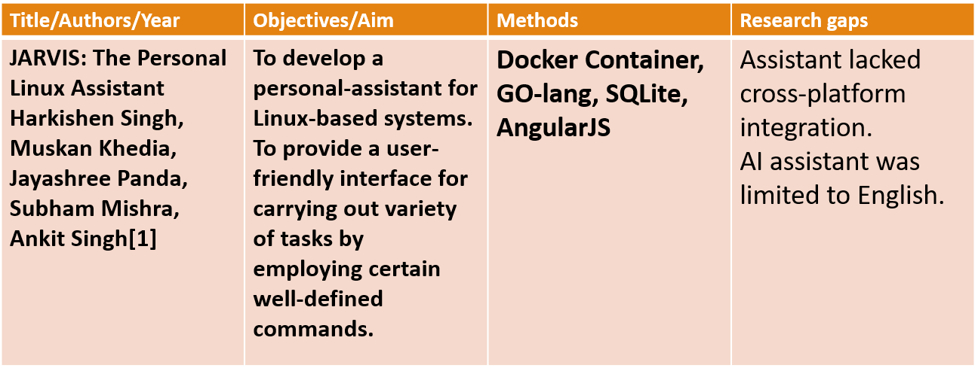
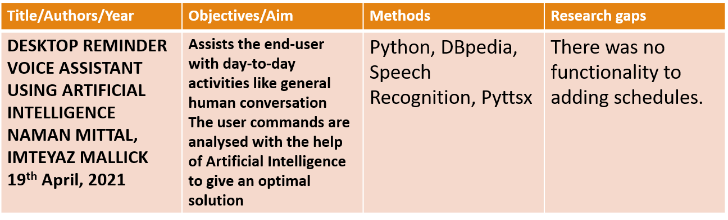
LITERATURE REVIEW

Slide 10
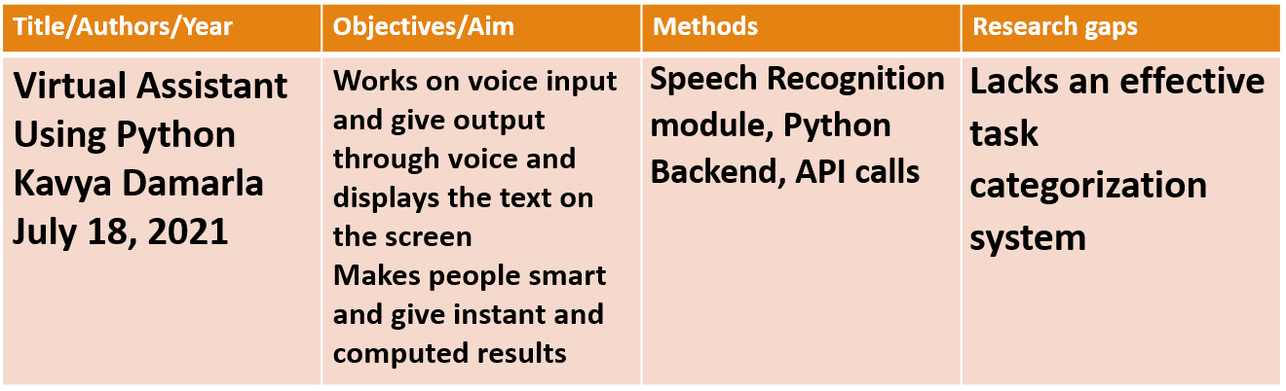
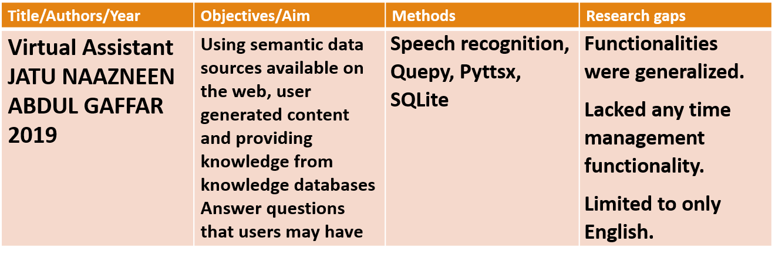
LITERATURE REVIEW

Slide 11
PROJECT SCOPE
Machine learning
Natural language processing
Speech recognition
User interaction
Time management

Slide 12
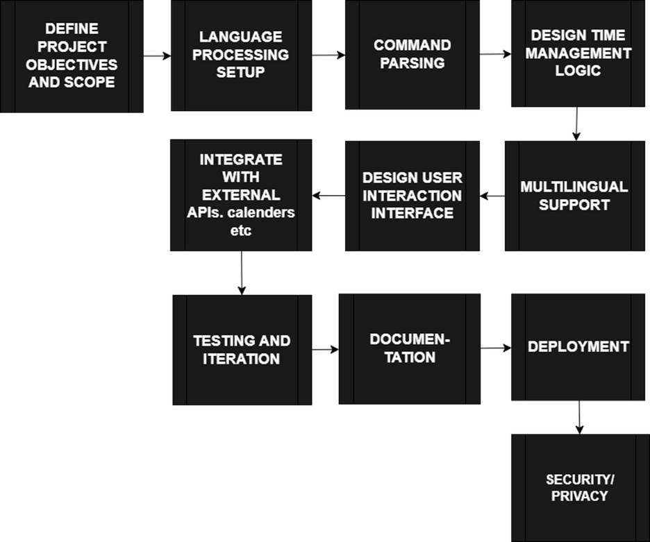
METHODOLOGY

Slide 13
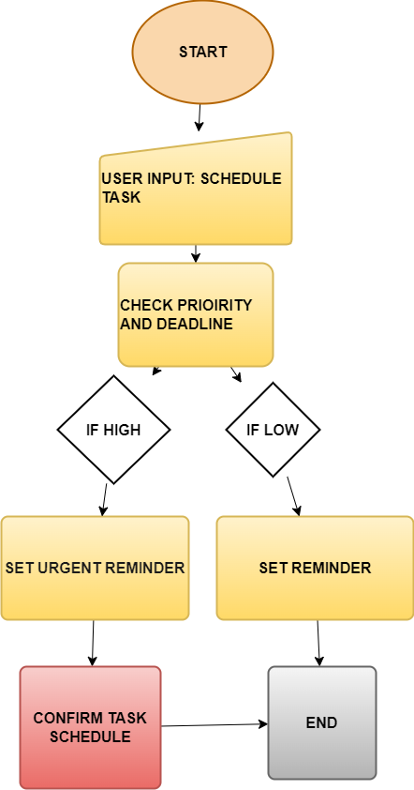
SYSTEM ARCHITECTURE

Slide 14
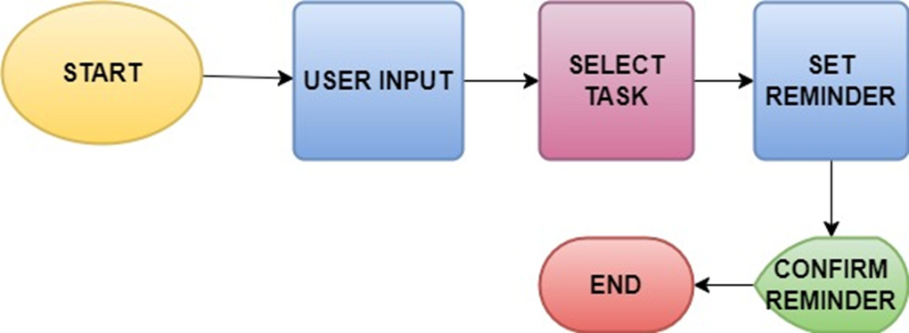
SYSTEM ARCHITECTURE
How system will implement reminder queries

Slide 15
FUNCTIONAL REQUIREMENTS
SPEECH RECOGNITION
COMMAND EXECUTION
NATURAL LANGUAGE PROCESSING
LANGUAGE UNDERSTANDING

Slide 16
NON-FUNCTIONAL REQUIREMENTS
SCALABILITY
PERFORMANCE
USABILITY
ACCURACY
RELIABILITY

Slide 17
EQUIPMENT
COMPUTING HARDWARE
Laptops
SOFTWARE TOOLS
Python
PERSONEL

Slide 18
EXPECTED OUTCOME
An efficient task scheduling and reminders assistant.
Accurate command execution in either English or Twi.
Positive user feedback and user-friendly Interface.
Completion within budget and time

Slide 19
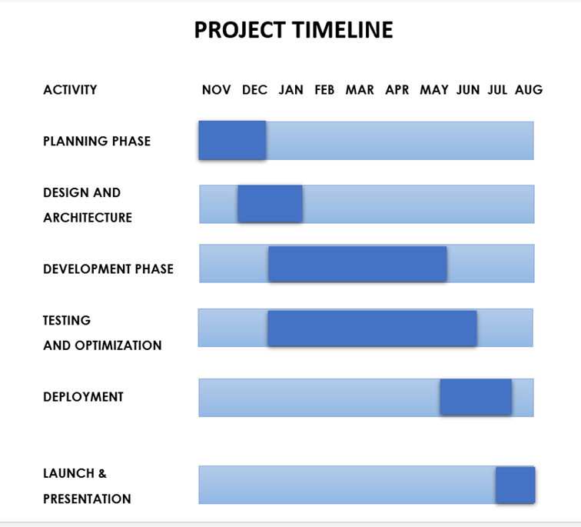
TIMELINE

Slide 20
CONCLUSION
Our project focuses on developing an AI based personal time management assistant leveraging a comprehensive methodology.
Our goal is to surpass the capabilities of generic voice assistants with a specific inclusion of effective scheduling and reminders.
Our multilingual AI assistant represents a transformative step towards a more inclusive and accessible digital future.

Slide 21
REFERENCES
[1] JARVIS: The Personal Linux Assistant Harkishen Singh, Muskan Khedia, Jayashree Panda, Subham Mishra, Ankit Singh
[2] Desktop voice assistant using artificial intelligence Naman Mittal,Imteyaz Mallick. 19th April, 2021
[3] Virtual Assistant Jatu Naazneen Abdul Gaffar.2019
[4] Virtual Assistant Using Python. Kavya Damarla. July 18, 2021
[5] www.wikipedia.com
[6] www.ghananlp.org

Slide 22
Thank You

